Slide 1



Fearing, Sleeping, & Constantly Weeping:
Neural gene transfection to dissect the neurocircuitry of PTSD, narcolepsy, and depression
Jazmine Yaeger

Slide 2




Post-Traumatic Stress Disorder
Chronic
Time
Acute

Slide 3
Post-Traumatic Stress Disorder
Not Easily Treated
Not Well Understood
Highly comorbid with other disorders:
  Alcoholism (55.5%)
  Specific Anxiety Disorders (33.3%)
  Depression (52.6%)
  Eating Disorders (20%)
  Sleep Disorders (Including Narcolepsy - 11.3%)
Perkonigg, A., et al. (2000). "Traumatic events and post‐traumatic stress disorder in the community: prevalence, risk factors and comorbidity." Acta Psychiatrica Scandinavica 101(1): 46-59.
Ohayon, M. M. (2013). "Narcolepsy is complicated by high medical and psychiatric comorbidities: a comparison with the general population." Sleep Medicine 14(6): 488-492.

Slide 4
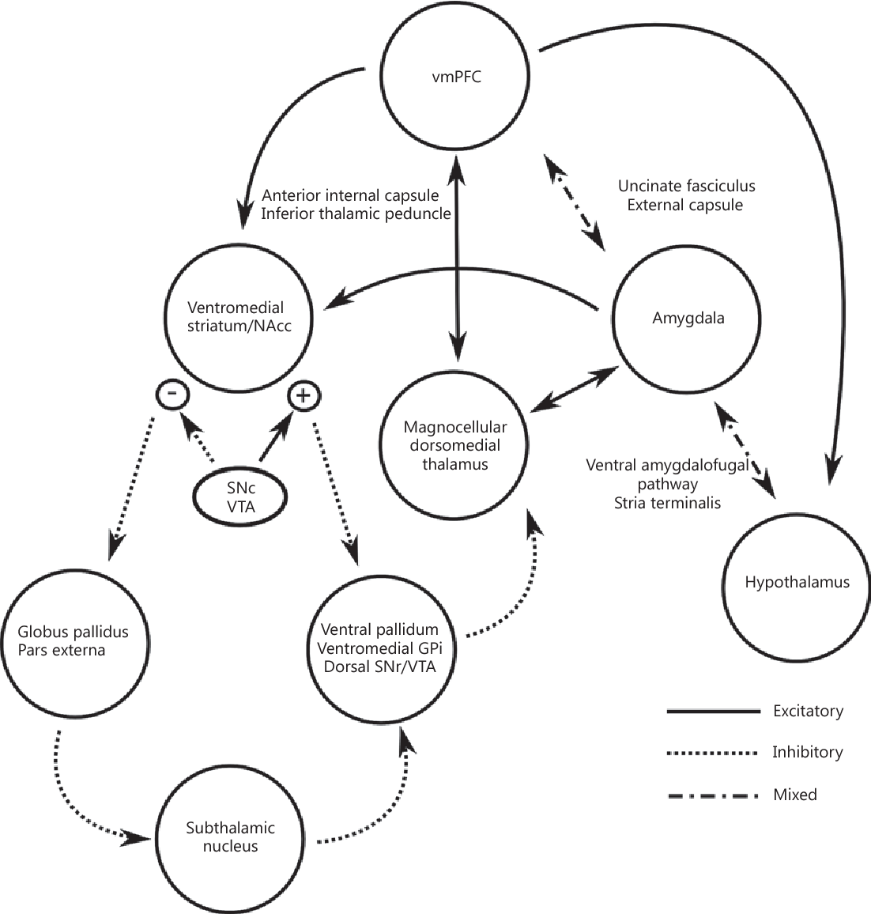
Post-Traumatic Stress Disorder
Reward and Motivation
Regulation of Autonomic Responses
Emotion Interpretation and Learning
Taghva, A., Oluigbo et al. (2013). Posttraumatic stress disorder: neurocircuitry and implications for potential deep brain stimulation. Stereotactic and functional neurosurgery, 91 4, 207-19.
Smith, K. S., Tindell et al. (2009). Ventral Pallidum Roles in Reward and Motivation. Behavioural Brain Research, 196(2), 155–167. http://doi.org/10.1016/j.bbr.2008.09.038

Slide 5
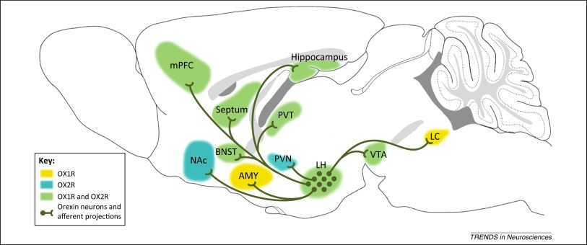
Post-Traumatic Stress Disorder
Flores, Á., et al. (2015). "Orexins and fear: implications for the treatment of anxiety disorders." Trends in Neurosciences 38(9): 550-559.

Slide 6
Post-Traumatic Stress Disorder
Glu
IL
mPFC
CeA
PrL
EC
lCeA
PAG
Glu
lcCeA
Glu
“Off”
mCeA
dl/lPAG
Mc
LA
“On”
Glu
mpITC
GABA
GABA
lpITC
GABA
GABA
Glu
ACh
Glu
GABA
vlPAG
GABA
Glu
ACh
SC
GABA
BLA
HYPOTHALAMUS
(PeF)
FEAR RESPONSE

Slide 7
Post-Traumatic Stress Disorder
Glu
IL
mPFC
CeA
PrL
EC
lCeA
PAG
Glu
lcCeA
Glu
“Off”
mCeA
dl/lPAG
Mc
LA
“On”
Glu
mpITC
GABA
GABA
lpITC
GABA
GABA
Glu
ACh
Glu
GABA
vlPAG
GABA
Glu
ACh
SC
GABA
BLA
HYPOTHALAMUS

Slide 8

Post-Traumatic Stress Disorder
Can neural gene transfection:
Help us understand more about the circuitry involved in PTSD (and other disorders)?
Guide the search for potential pharmacotherapies?

Slide 9
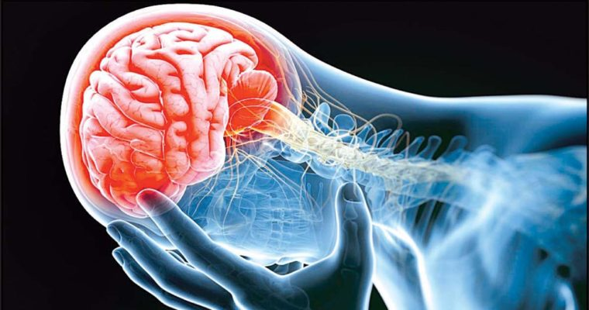
Panic results in unique molecular and network changes in the amygdala that facilitate fear responses
Molosh et al.

Slide 10

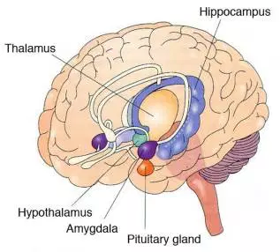
Panic
Uncontrollable fear state
Involves limbic system activation
Can be simulated experimentally
  Inhibition of GABA signaling in DMH/PeF
  Sodium Lactate Infusions
  CO₂ Challenge
Johnson, P. L. and A. Shekhar (2012). "An animal model of panic vulnerability with chronic disinhibition of the dorsomedial/perifornical hypothalamus." Physiology & Behavior 107(5): 686-698.
Johnson, P. L., et al. (2008). "Neural pathways underlying lactate induced panic." Neuropsychopharmacology : official publication of the American College of Neuropsychopharmacology 33(9): 2093-2107.
Johnson, P. L., et al. (2005). "Acute hypercarbic gas exposure reveals functionally distinct subpopulations of serotonergic neurons in rats." Journal of Psychopharmacology 19(4): 327-341.

Slide 11
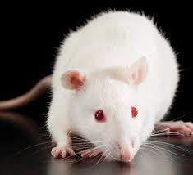
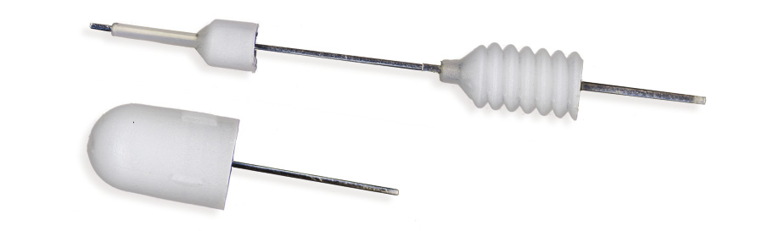
Stereotaxic Surgery
Transfection of PeF Neurons
Optic Fibers Targeting BLA (bilateral)

Slide 12
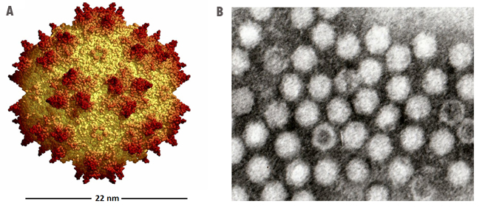
Transfect PeF Neurons
AAV5-CaMKIIα-ChR2(H134R)-EYFP
AAV5-CaMKIIα-GFP
Adeno-Associated Virus (Serotype 5) – high CNS transfection frequency
Promoter Specifying Glutamatergic Neurons (Calcium/Calmodulin-dependent Kinase II alpha)
Light-Sensitive (490 nm) Channel Rhodopsin
Enhanced Yellow Fluorescent Protein
Green Fluorescent Protein
http://signagen.com/Introduction-to-AAV
Wu, Z., et al. (2006). "Adeno-associated Virus Serotypes: Vector Toolkit for Human Gene Therapy." Molecular Therapy 14(3): 316-327.

Slide 13
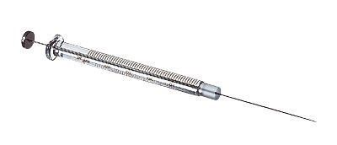

Transfect PeF Neurons
Glu
IL
mPFC
CeA
PrL
EC
lCeA
PAG
Glu
lcCeA
Glu
“Off”
mCeA
dl/lPAG
Mc
LA
“On”
Glu
mpITC
GABA
GABA
lpITC
GABA
GABA
Glu
ACh
Glu
GABA
vlPAG
GABA
Glu
ACh
SC
GABA
BLA
HYPOTHALAMUS
(PeF)

Slide 14
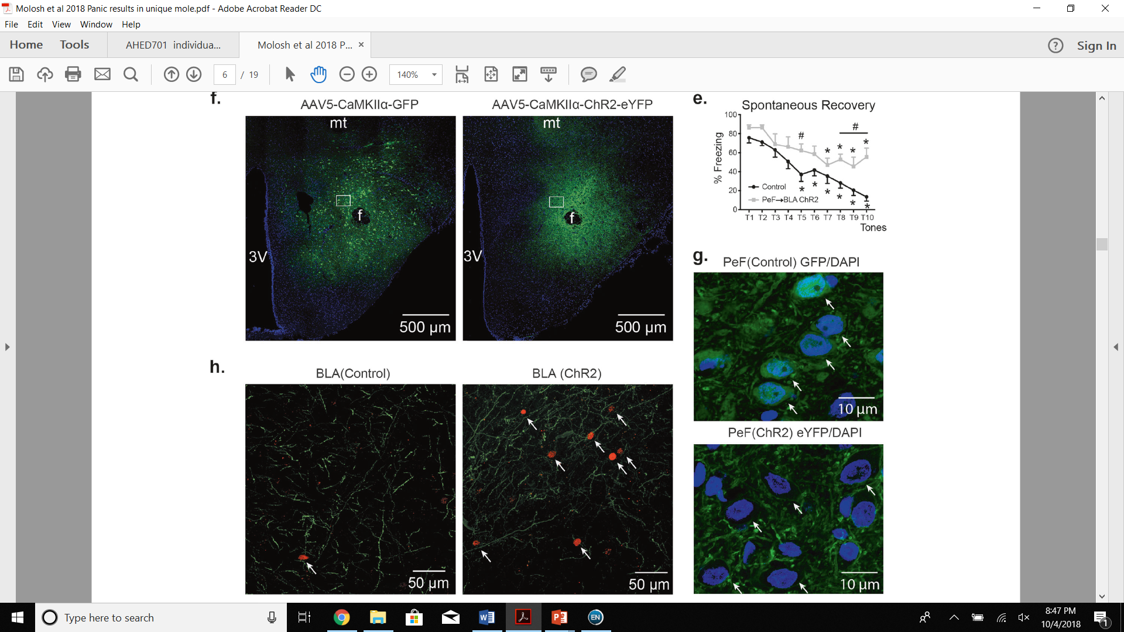
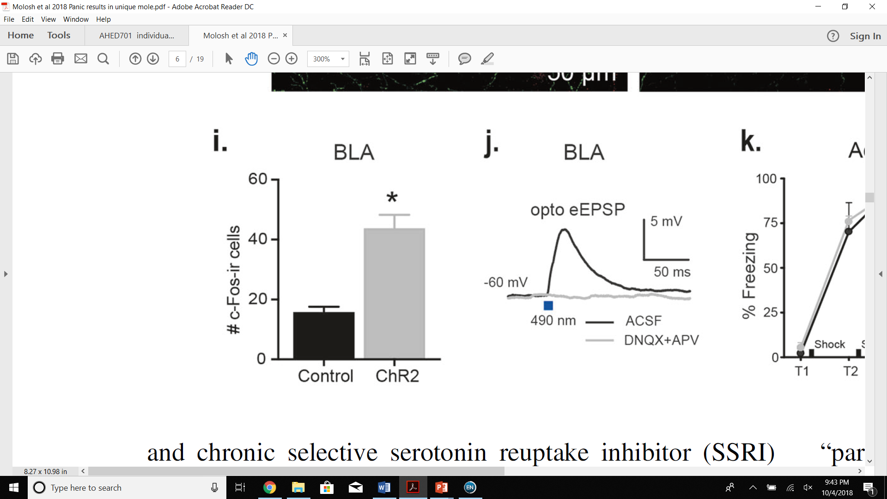
Transfect PeF Neurons
= AMPA & NMDA Antagonists

Slide 15
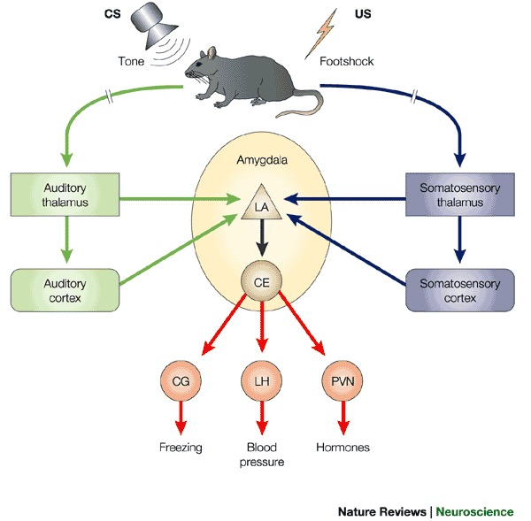
Fear Conditioning
Medina, J., et al. (2002). Parallels between cerebellum- and amygdala-dependent conditioning.

Slide 16
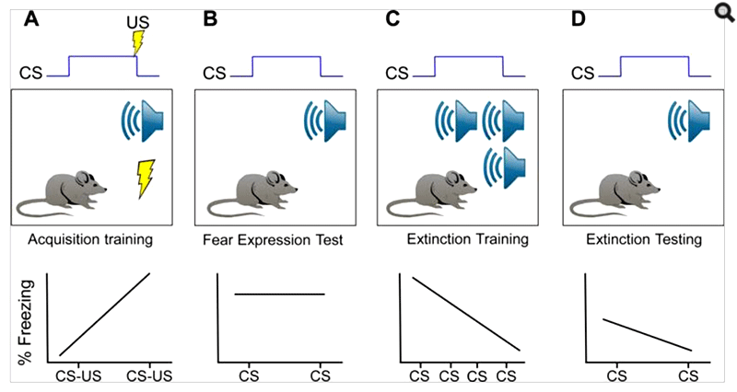
Fear Conditioning
Cohodes, E., & Gee, D. (2017, December 19). Developmental Neurobiology of Anxiety and Related Disorders. Oxford Research Encyclopedia of Neuroscience. Ed.

Slide 17
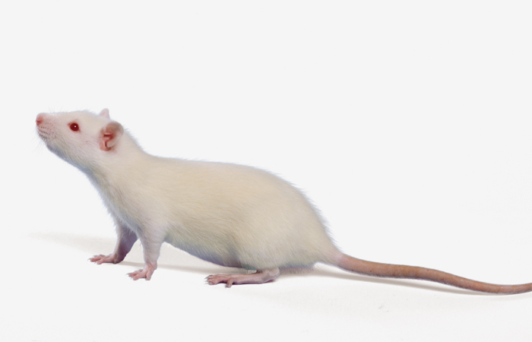
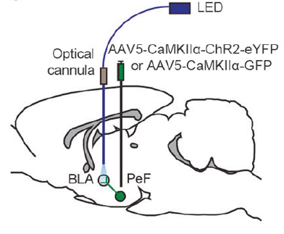
Intra-BLA Stimulation during Fear Conditioning

Slide 18
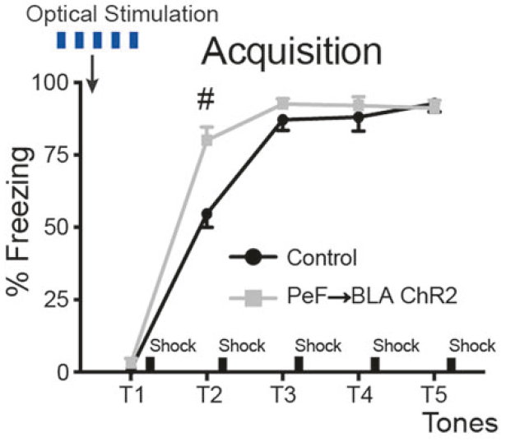
Intra-BLA Stimulation during Fear Conditioning
Stimulation of Glutamatergic PeF → BLA Projections Enhanced Acquisition of Conditioned Fear

Slide 19
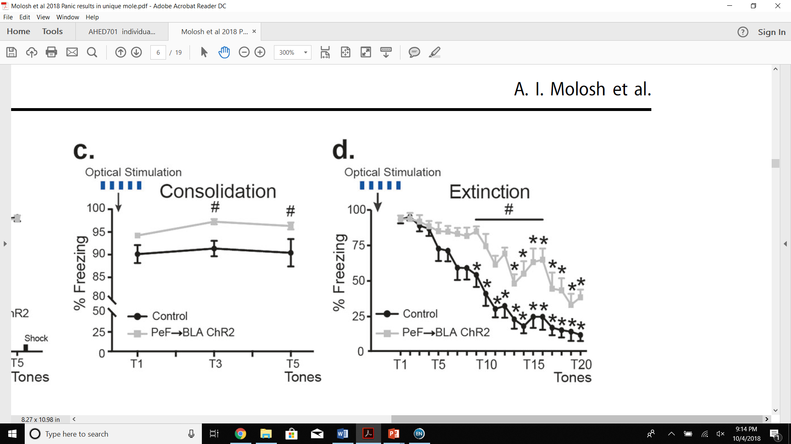
Intra-BLA Stimulation during Fear Conditioning
Stimulation of Glutamatergic PeF → BLA Projections Enhanced Consolidation of Conditioned Fear

Slide 20
Intra-BLA Stimulation during Fear Conditioning
Stimulation of Glutamatergic PeF → BLA Projections Delayed Extinction of Conditioned Fear

Slide 21
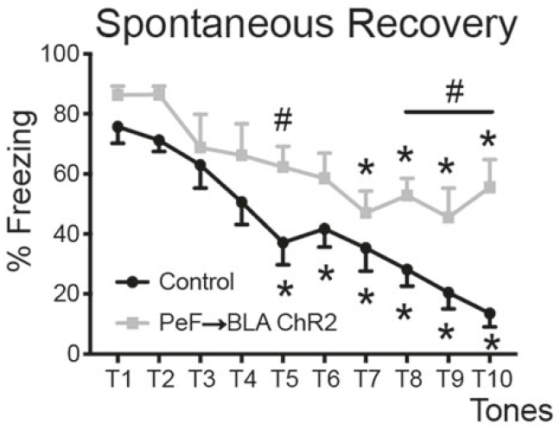
Intra-BLA Stimulation during Fear Conditioning
Stimulation of Glutamatergic PeF → BLA Projections Enhanced Persistence of Conditioned Fear

Slide 22
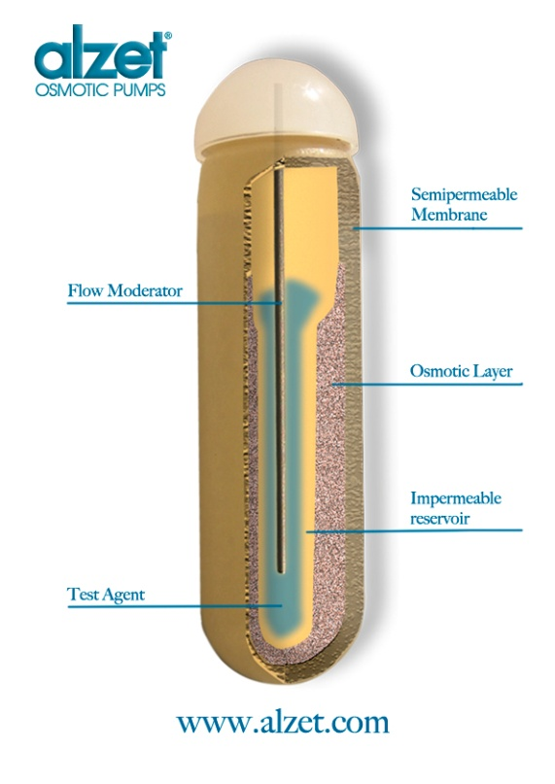
Stereotaxic Surgery
Cannula Targeting PeF
with
Osmotic Pump Delivering 1-AG or d-AG
1-AG mimics panic state by blocking GABAergic tone in PeF
1-AG = 1-allyglycine = glutamic acid decarboxylase (GAD) inhibitor
d-AG = inactive isomer of 1-AG

Slide 23
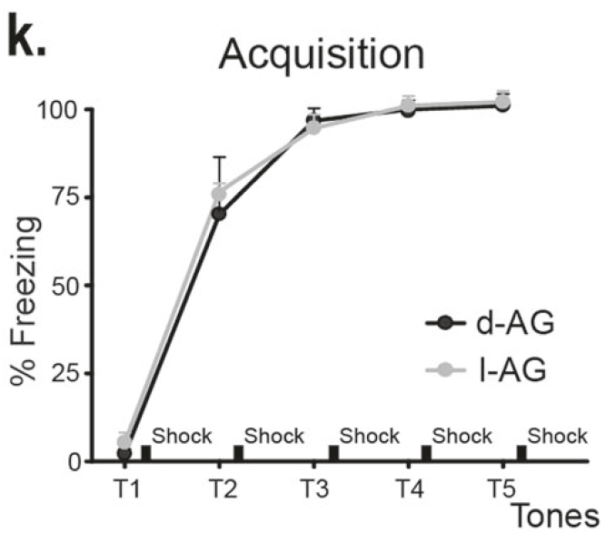
1-AG-Induced Panic during Fear Conditioning
1-AG did Not Enhance Acquisition of Conditioned Fear

Slide 24

1-AG-Induced Panic during Fear Conditioning
1-AG Delayed Extinction of Conditioned Fear

Slide 25
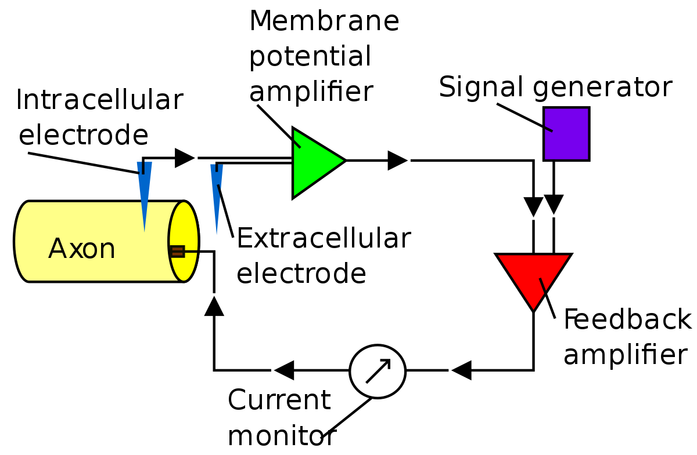
Electrophysiology

Slide 26
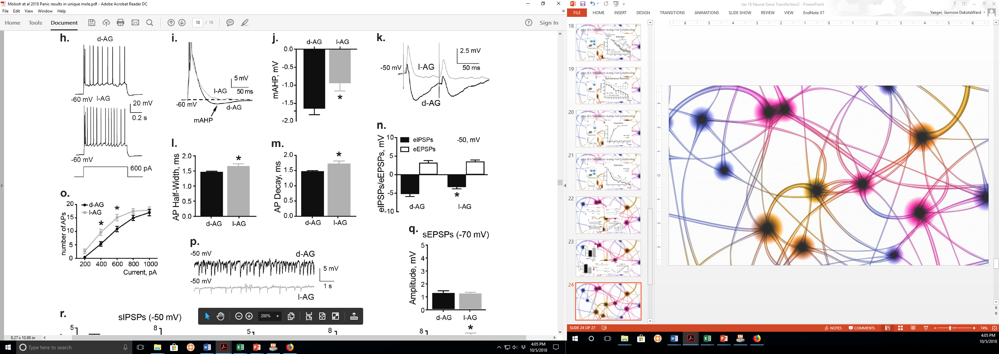
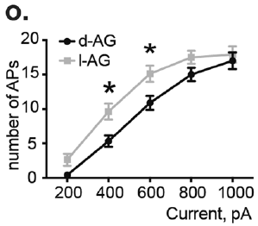
Exploring Synaptic Properties of BLA Pyramidal Neurons
7 Days of 1-AG ↑ Excitability of BLA Pyramidal Neurons

Slide 27
Exploring Synaptic Properties of BLA Pyramidal Neurons
7 Days of 1-AG ↓ mAHP in BLA Pyramidal Neurons
(↑ Neuronal Excitability)
mAHP = medium after hyperpolarization – dependent on the number of AP spikes

Slide 28
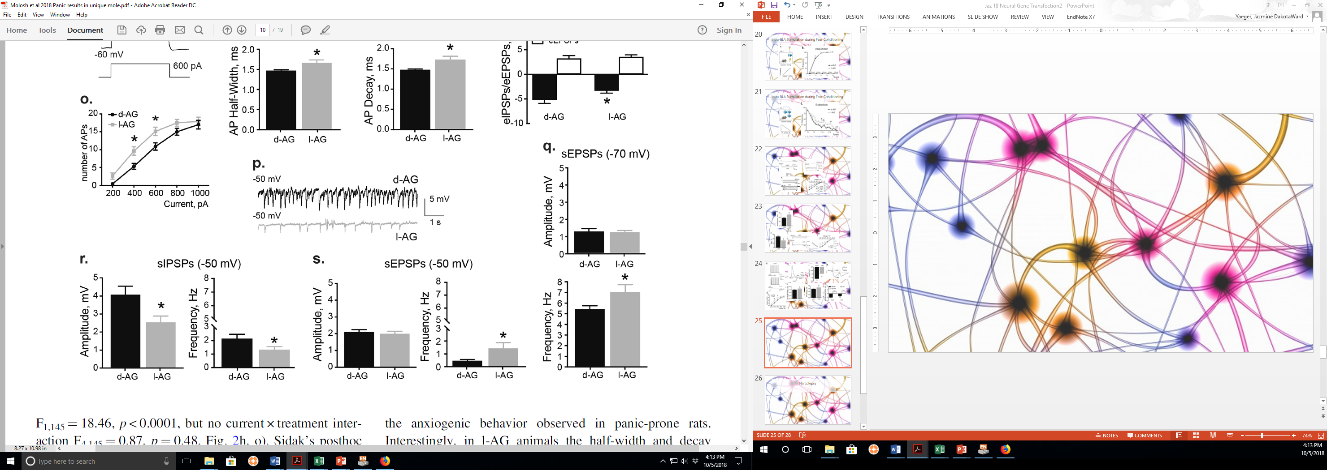
Exploring Synaptic Properties of BLA Pyramidal Neurons
7 Days of 1-AG ↑ sEPSP frequency and ↓ sIPSP frequency in BLA Pyramidal Neurons
(Makes BLA Pyramidal Neurons More Sensitive)
sEPSPs = spontaneous Excitatory Post-Synaptic Potentials
sIPSPs = spontaneous Inhibitory Post-Synaptic Potentials

Slide 29
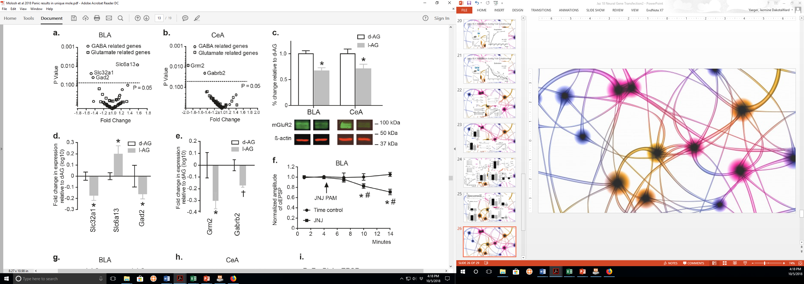
Molecular Changes in BLA of Panic-Prone Animals
7 Days of 1-AG Upset GABA-related Gene Expression in the BLA
Slc32a1 = GABA vesicular transporter
Slc6A13 = GABA transporter (Gat-2)
Gad2 = Glutamic acid decarboxylase 2 (Gad65)

Slide 30
Molecular Changes in CeA of Panic-Prone Animals
7 Days of 1-AG Upset GABA- & Glutamate-related Gene Expression in the CeA
Grm2 = metabotropic glutamate receptor 2
Gabrb2 = GABA_{A} receptor β₂ subunit

Slide 31
Molecular Changes in BLA & CeA of Panic-Prone Animals
7 Days of 1-AG ↓ mGluR2 Protein Levels in BLA and CeA

Slide 32
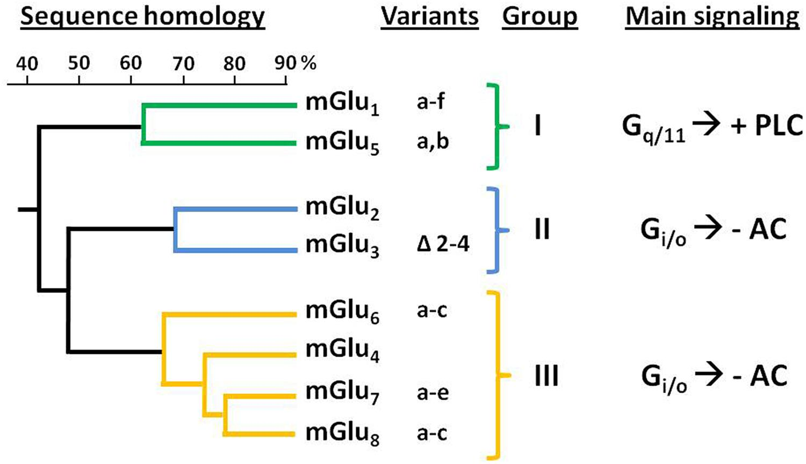
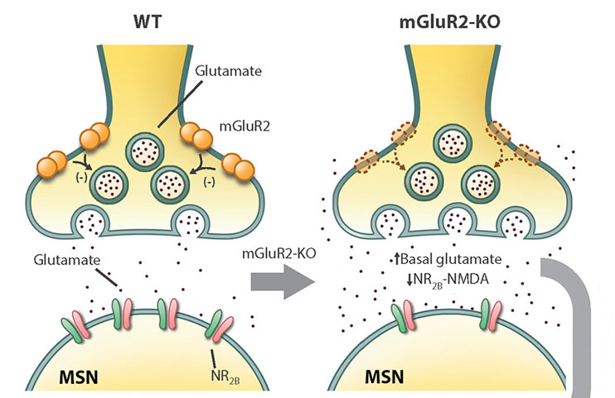
What is mGluR2?

Slide 33
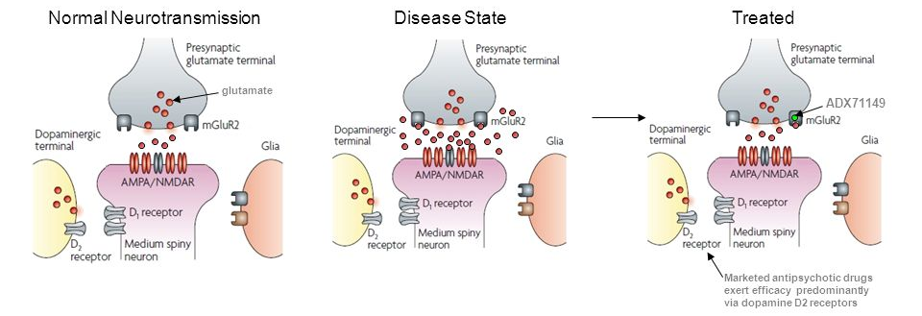
What is mGluR2?
PAMs = Positive Allosteric Modulators
For mGluR2:
  JNJ-42153605
  JNJ-40411813 (ADX71149)

Slide 34
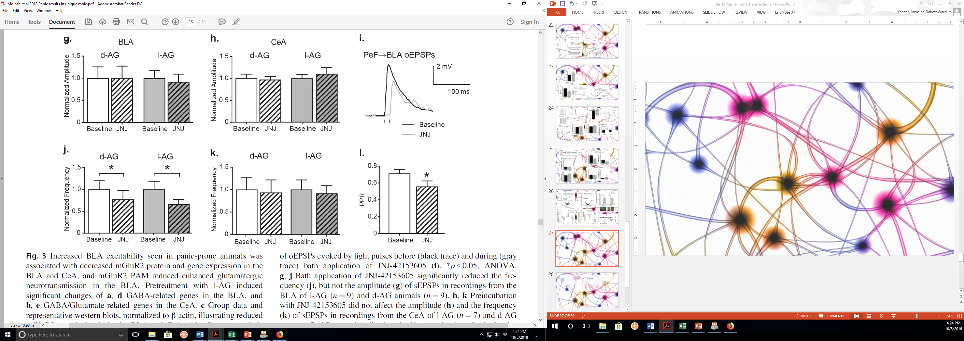
in vivo Synaptic Properties in BLA with Pharmacological Intervention
PAM ↓ Amplitude of oEPSPs in BLA
oEPSPs = optogenetic-evoked Excitatory Post-Synaptic Potentials

Slide 35
in vivo Synaptic Properties in BLA with Pharmacological Intervention
PAM ↓ sEPSP Frequency in BLA
REMEMBER:

Slide 36
in vivo Synaptic Properties in BLA with Pharmacological Intervention
mGluR2
JNJ
Glutamate (AMPA, NMDA) Receptors
PPR = Paired-Pulse Ratio (oEPSP₂/oEPSP₁)

Slide 37
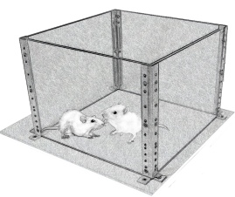
Pharmacological Intervention and Anxious Behaviors
SI Test

Slide 38
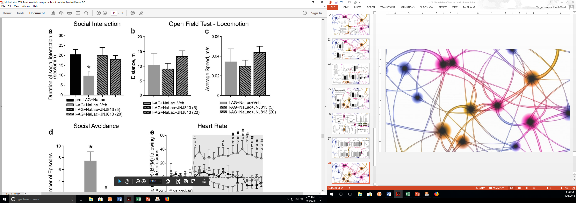
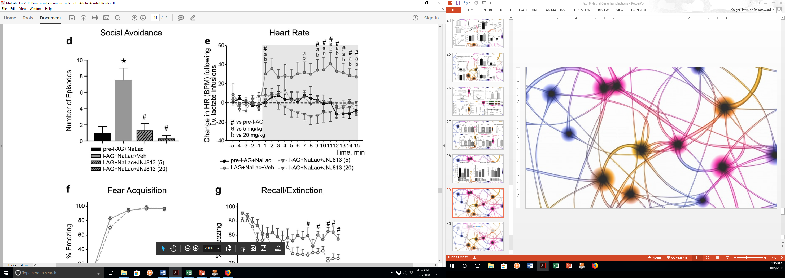
Pharmacological Intervention and Anxious Behaviors
PAM Attenuated Social Avoidance Behavior in Panic-Prone Rats

Slide 39
Pharmacological Intervention and Physiological Response
PAM Attenuated Cardiovascular Changes in Panic-Prone Rats

Slide 40
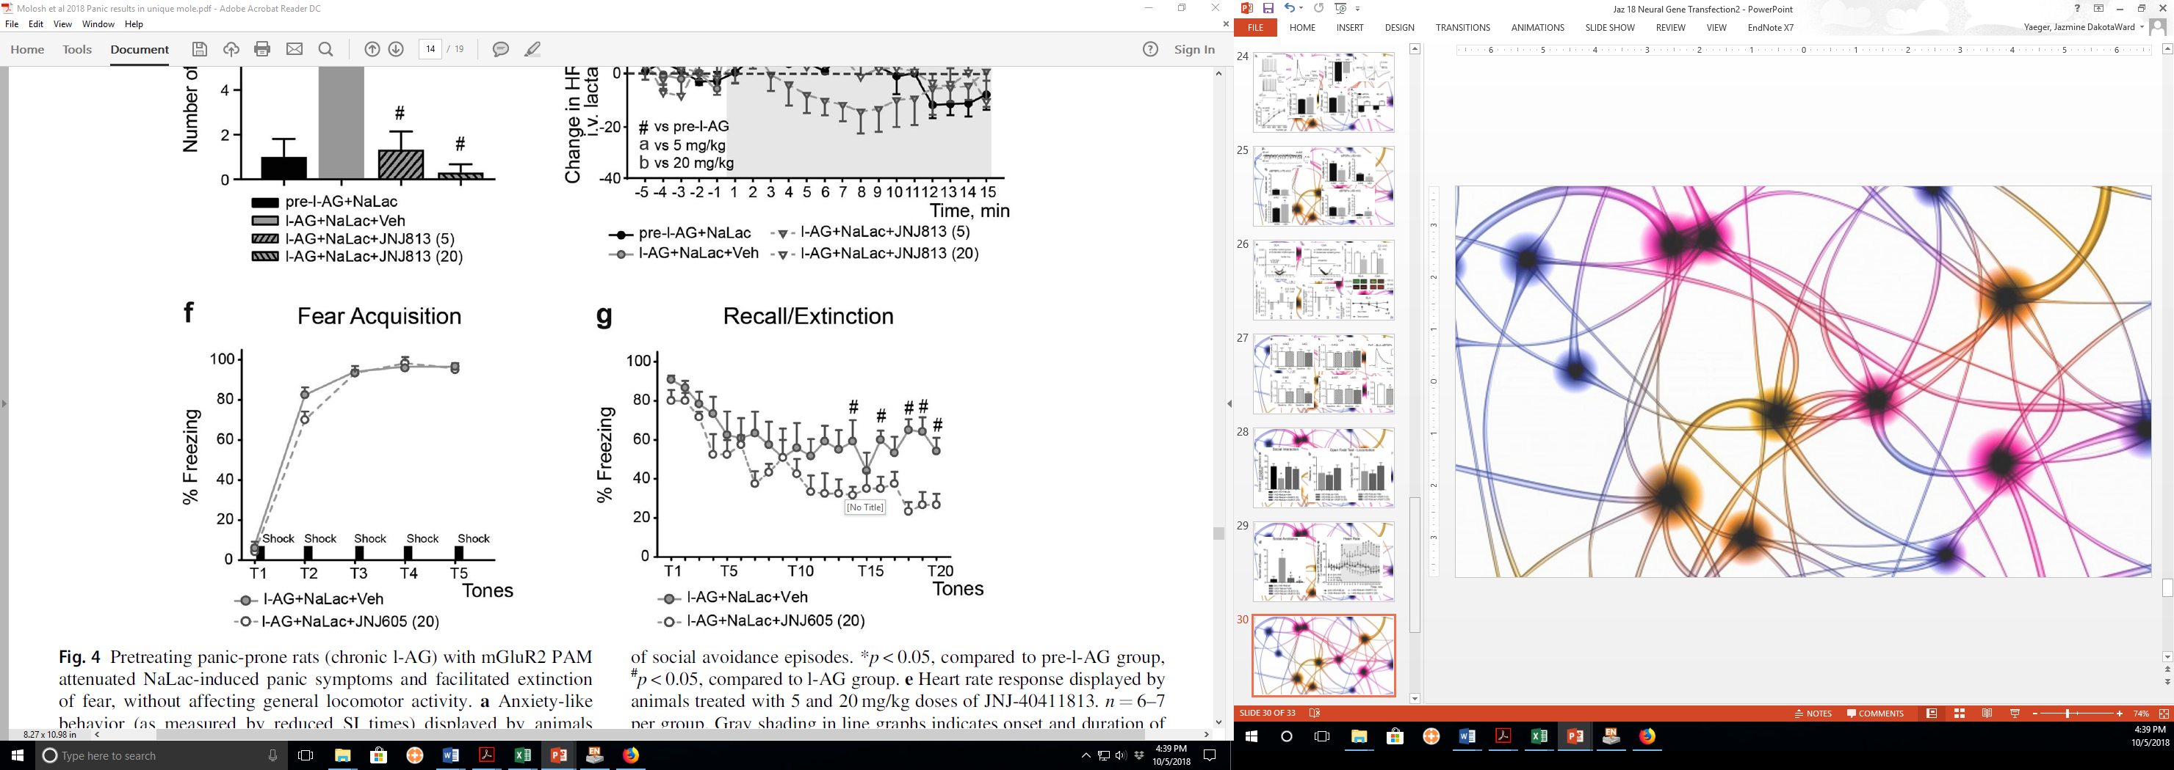
Pharmacological Intervention and Behavior
PAM did Not Change Fear Response during Acquisition in Panic-Prone Rats

Slide 41
Pharmacological Intervention and Behavior
PAM ↓Fear Response during Extinction and Recall in Panic-Prone Rats

Slide 42
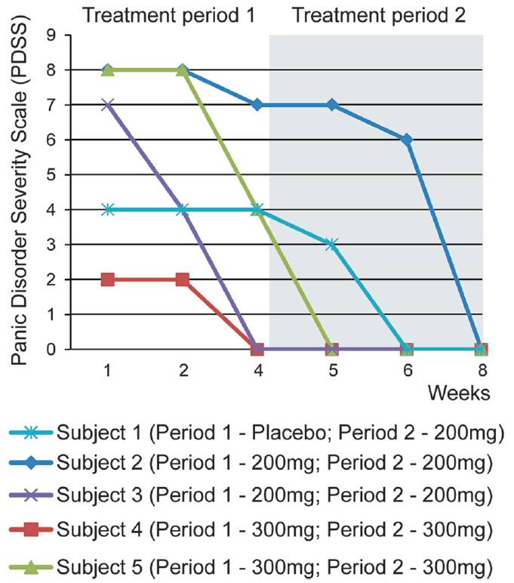
Pharmacological Intervention in Humans

Slide 43
Brief Recap
↑ PeF Activity:
  ↑ Fear Acquisition, ↑ Fear Consolidation, ↓ Extinction
Panic:
  Disrupts synaptic function in amygdala
  mGluR2 is involved
PAMs:
  Corrects synaptic function in amygdala
  ↓ Panic Response in rats and humans

Slide 44
Brief Recap
Glu
IL
mPFC
CeA
PrL
EC
lCeA
PAG
Glu
lcCeA
Glu
“Off”
mCeA
dl/lPAG
Mc
LA
“On”
Glu
mpITC
GABA
GABA
lpITC
GABA
GABA
Glu
ACh
Glu
GABA
vlPAG
GABA
Glu
ACh
SC
GABA
BLA
HYPOTHALAMUS
(PeF)

Slide 45


Brief Recap
PANIC-PRONE
NORMAL FUNCTION
mGluR2
JNJ
BLA Pyramidal Neuron
From PeF
Glutamate (AMPA, NMDA) Receptors

Slide 46

So…
Gene transfection can give us insight into amygdala circuitry & PTSD…
But…
What about narcolepsy?

Slide 47
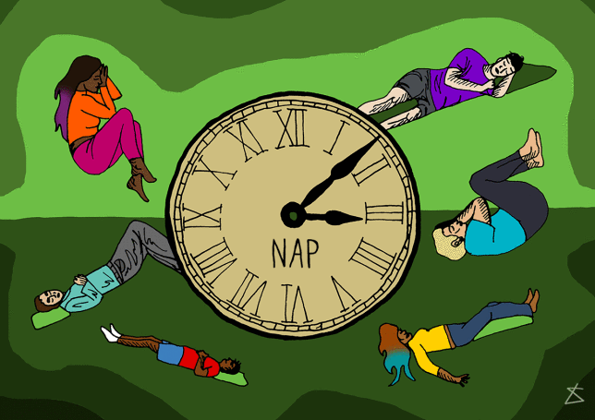
Orexin gene transfer into the amygdala suppresses both spontaneous and emotion-induced cataplexy in orexin-knockout mice
Liu et al.

Slide 48
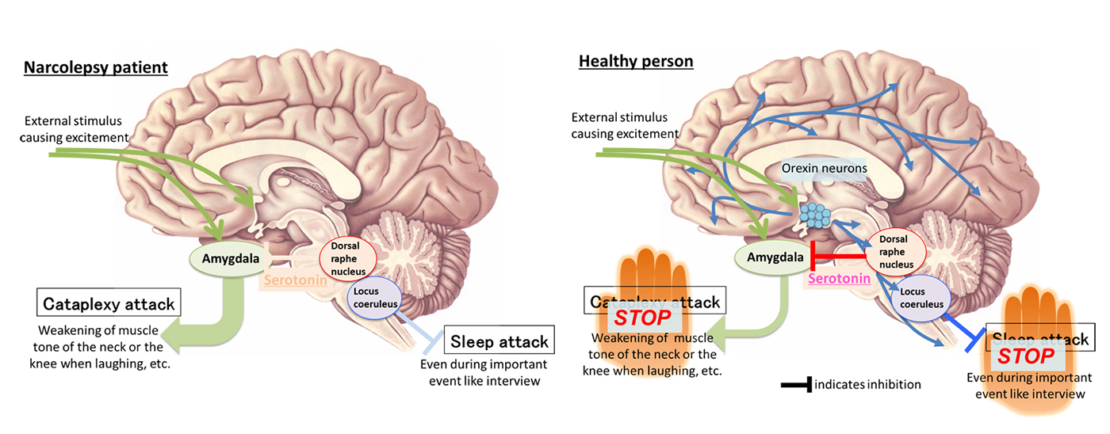

Narcolepsy
Excessive Daytime Sleepiness
Extreme – Falling Asleep after Periods of Extreme Emotion
  Marked by loss of muscle tone – Cataplexy
  Linked to a reduction in Orexin

Slide 49
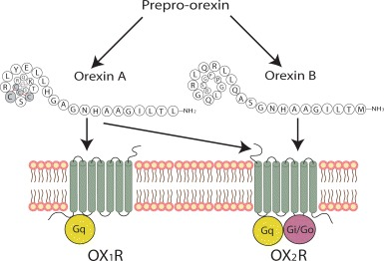
The Orexin System
Peptide Neurohormone
  2 Types From Single Precursor Protein
    Orexin A (Hypocretin 1) → 33 aa
      Binds Orx₁ & Orx₂ receptors with approximately equal affinity
    Orexin B (Hypocretin 2) → 28 aa
      Binds Orx₂ receptor equally well as Orexin A, but has 500x less affinity for Orx₁
Holland, P. and P. J. Goadsby (2007). "The hypothalamic orexinergic system: pain and primary headaches." Headache: The Journal of Head and Face Pain 47(6): 951-962.

Slide 50
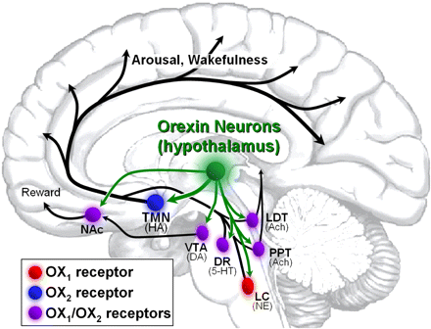
The Orexin System
Orexin has far-reaching influences on brain activity/behavior
LH-DMH/
PeF
Orx co-localized with
Glutamate
Gotter, A. L., et al. (2012). "International Union of Basic and Clinical Pharmacology. LXXXVI. Orexin receptor function, nomenclature and pharmacology." Pharmacological reviews 64(3): 389-420.

Slide 51



The Orexin System
Important role in regulating:
  Arousal/Wakefulness
  Appetite
  Anxiety

Slide 52
The Orexin System and Cataplexy

Slide 53


Stereotaxic Surgery
Viral Vector
Monitor Cataplexy Behavior and Sleep Patterns with and without Predatory Odor (Stimulates Negative Emotion – Fear)
29 Days

Slide 54
Transfect Amygdala Neurons
rAAV-CMV-Orexin-GFP
rAAV-CMV-GFP
Recombinant Adeno-Associated Virus
Cytomegalovirus Promoter
Prepro-orexin Gene
Green Fluorescent Protein
http://signagen.com/Introduction-to-AAV
Wu, Z., et al. (2006). "Adeno-associated Virus Serotypes: Vector Toolkit for Human Gene Therapy." Molecular Therapy 14(3): 316-327.

Slide 55
Transfect Amygdala Neurons
100 μm
100 μm

Slide 56
Transfect Amygdala Neurons
25 μm
25 μm
25 μm
25 μm
25 μm
25 μm

Slide 57
Orexin Gene Transfer and Cataplexy
Orexin Gene Transfer into the Amygdala Reduced Cataplexy

Slide 58
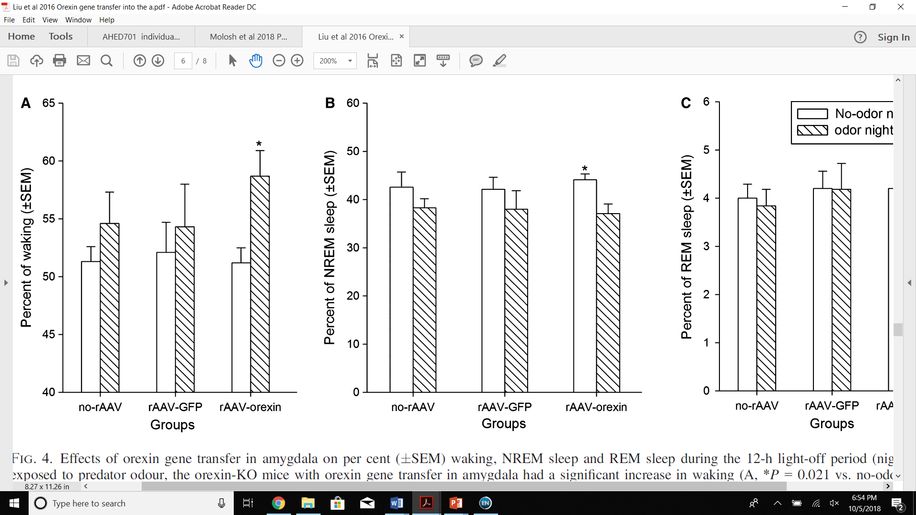
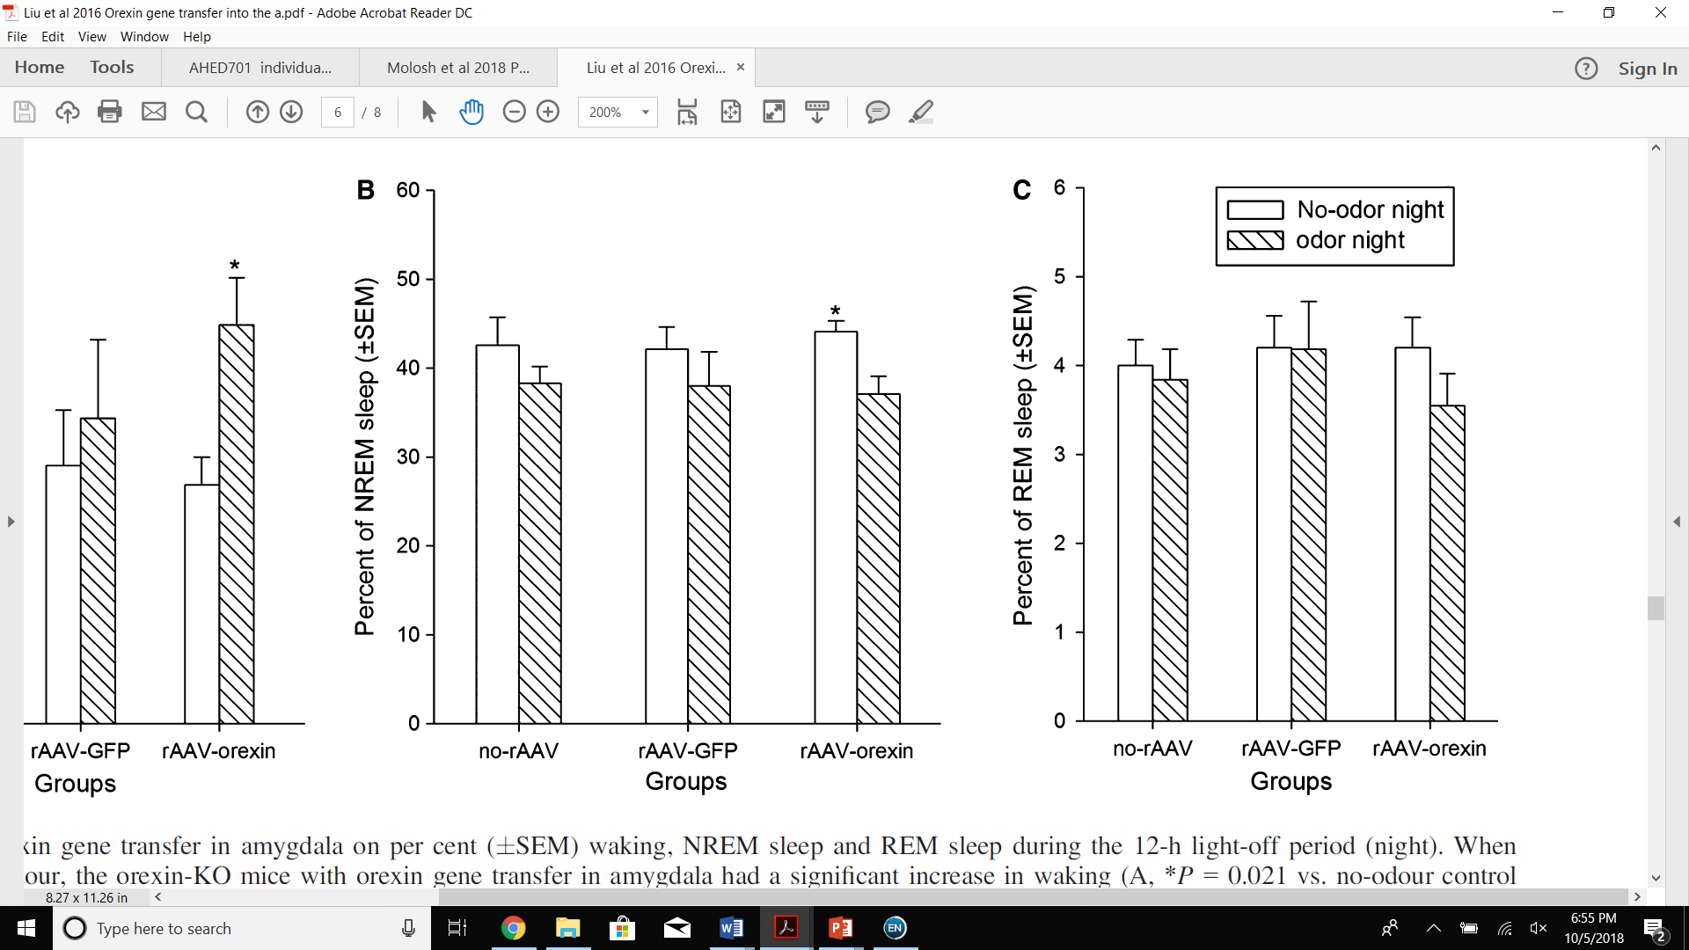
Orexin Gene Transfer and Sleep Cycle
Orexin Gene Transfer into the Amygdala Promoted Waking and Decreased NREM Sleep with Predatory Odor Present

Slide 59
Orexin Gene Transfer to Reduce Cataplexy in Orexin KO Mice

Slide 60
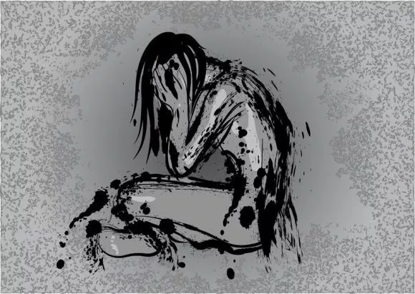
So…
Gene transfection of orexin into the amygdala can correct cataplexy…
But…
What can gene transfection tell us about depression?

Slide 61

Orexin prevents depressive-like behavior by promoting stress resilience
Ji et al.

Slide 62
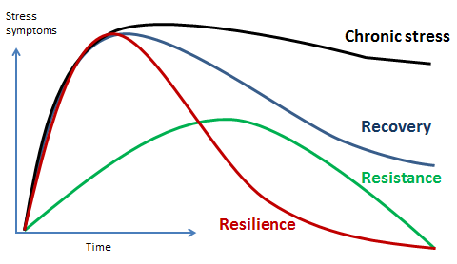
Stress Resilience
Norris, F. H., et al. (2009). "Looking for resilience: Understanding the longitudinal trajectories of responses to stress." Social science & medicine 68(12): 2190-2198.
.

Slide 63
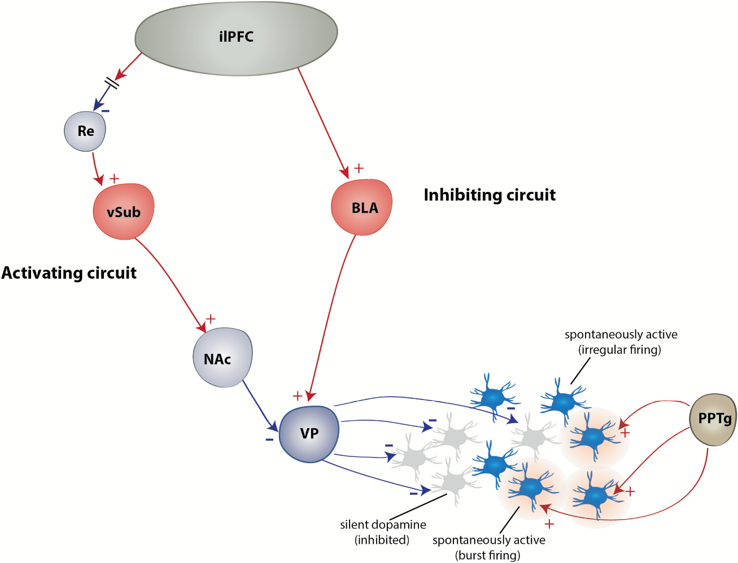
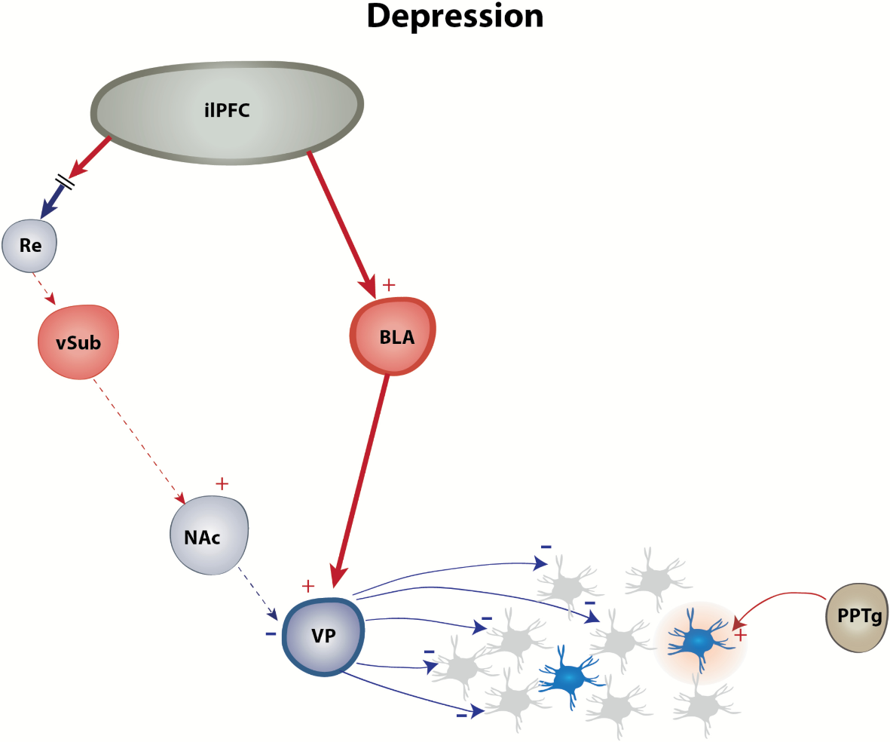
Ventral Pallidum and Depression
ilPFC = infralimbic region of the prefrontal cortex
vSub = ventral subiculum of the hippocampus
NAc = nucleus accumbens
PPTg = pedunculopontine tegmental nucleus
Belujon, P. and A. A. Grace (2017). "Dopamine System Dysregulation in Major Depressive Disorders." International Journal of Neuropsychopharmacology 20(12): 1036-1046..

Slide 64
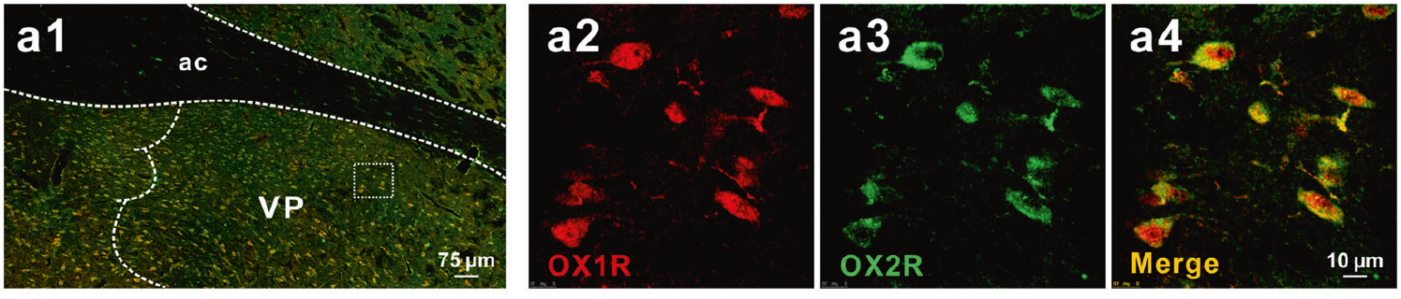
Orexin Receptors in VP

Slide 65

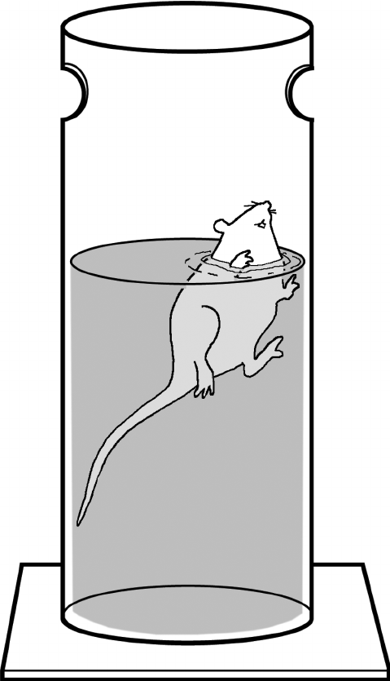
Orexin Receptors and Behavioral Despair
Blocking Orexin Receptors in the VP ↑ Behavioral Despair
TCS1102 = DORA = Dual Orexin Receptor Antagonist

Slide 66
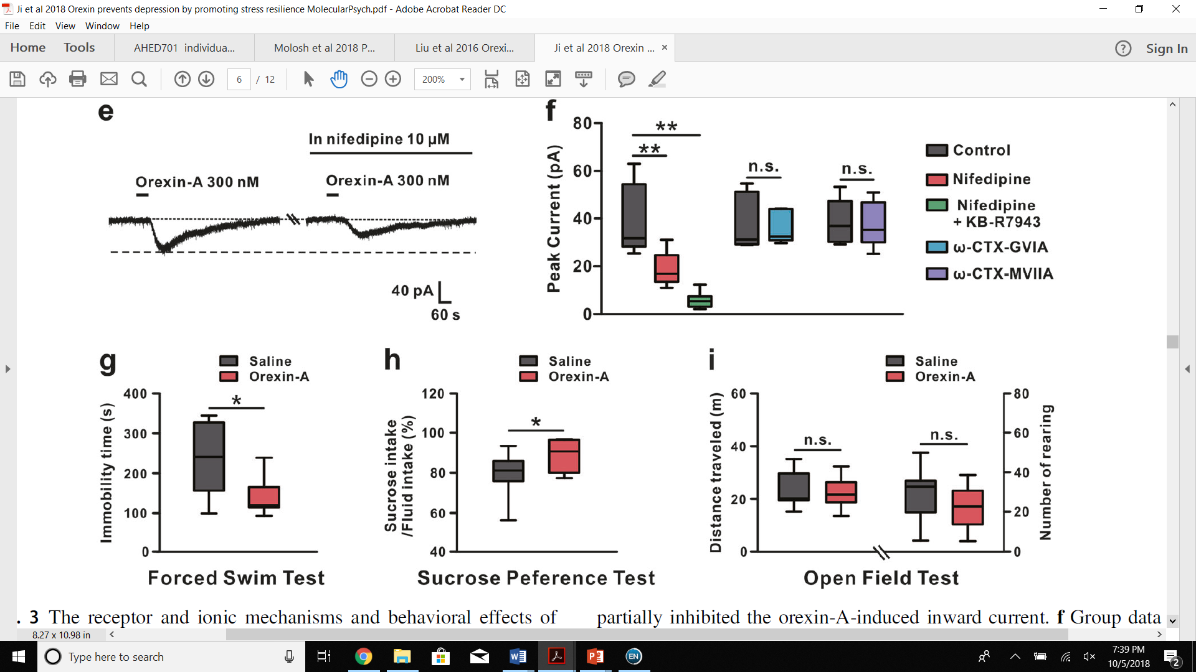
Orexin Receptors and Behavioral Despair
Stimulating Orexin Receptors in the VP ↓ Behavioral Despair

Slide 67
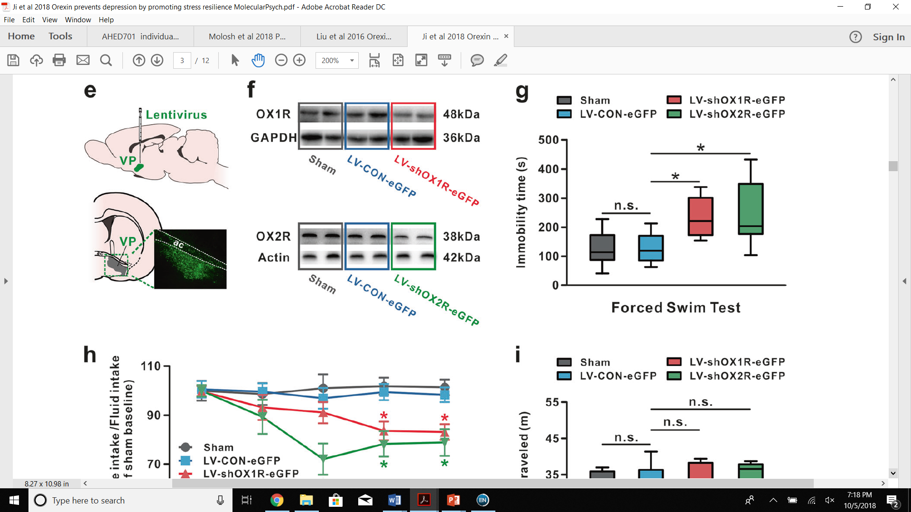
Transfect VP Neurons

Slide 68

Transfect VP Neurons
LV-shOX1R-eGFP
LV-shOX2R-eGFP
LV-CON-eGFP
Lentivirus
Short hairpin RNA for orexin 1 receptor
Short hairpin RNA for orexin 2 receptor
Short hairpin RNA for scrambled sequence
Enhanced Green Fluorescent Protein

Slide 69
Orexin Receptors and Behavioral Despair
Knocking down Orexin Receptors in the VP ↑ Behavioral Despair

Slide 70
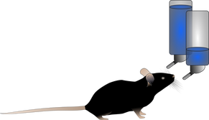
Orexin Receptors and Anhedonia
Blocking Orexin Receptors in the VP ↑ Anhedonia
TCS1102 = DORA = Dual Orexin Receptor Antagonist

Slide 71
Orexin Receptors and Anhedonia
Stimulating Orexin Receptors in the VP ↓ Anhedonia

Slide 72
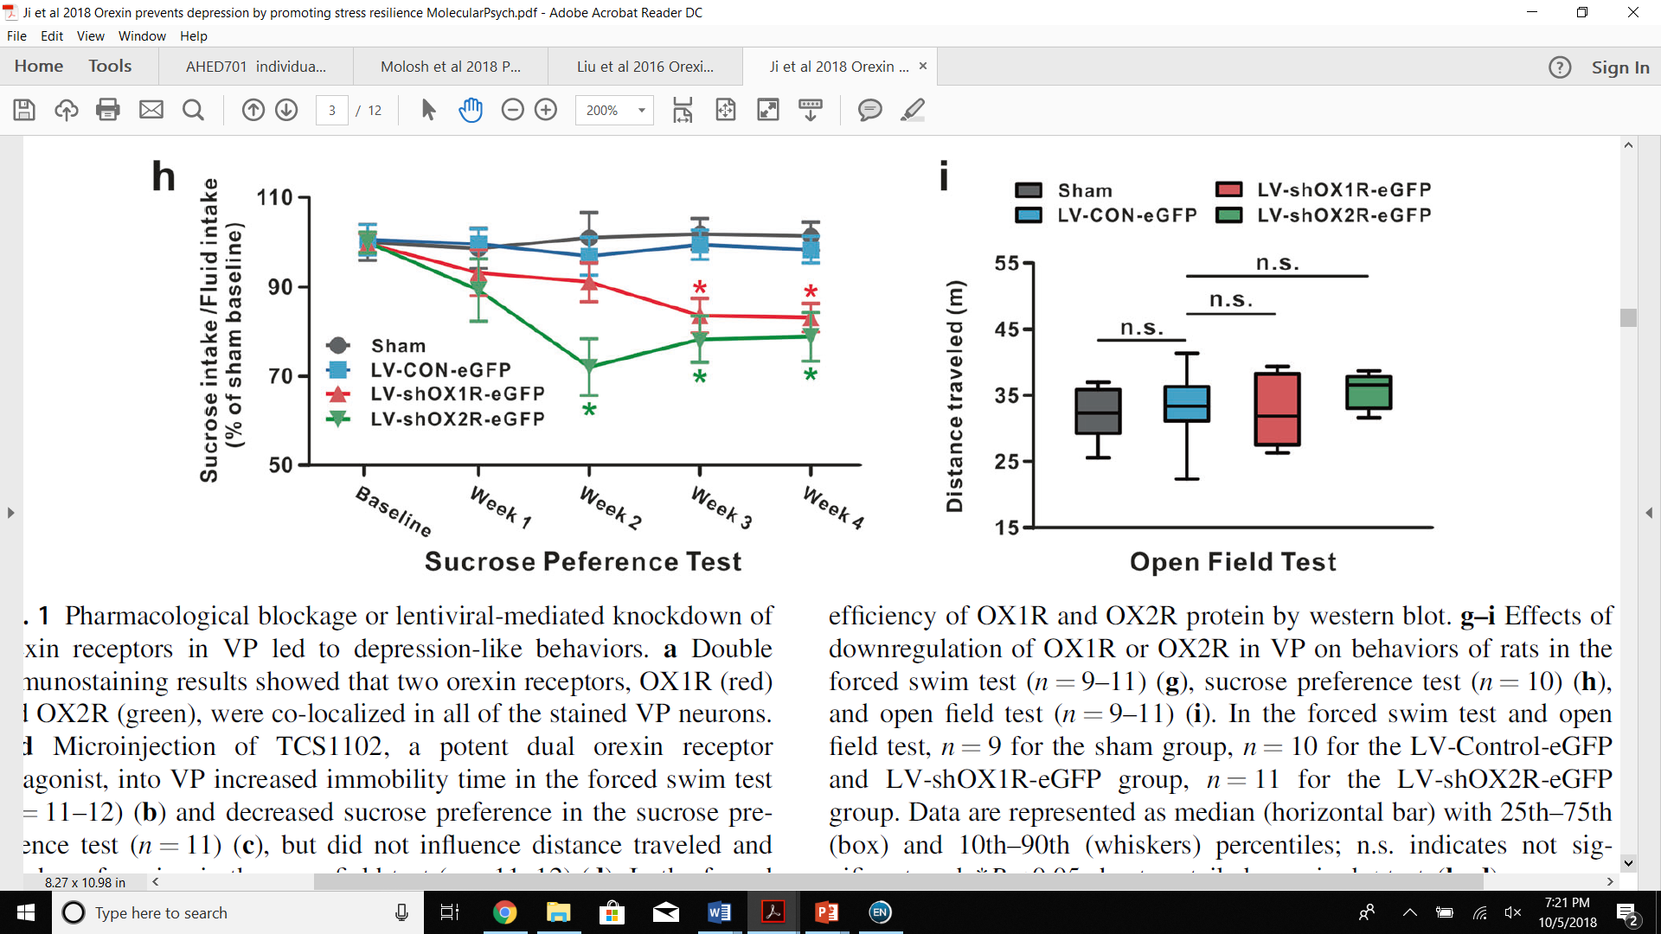
Orexin Receptors and Anhedonia
Knocking down Orexin Receptors in the VP ↑ Anhedonia

Slide 73
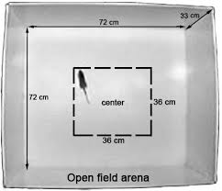

Orexin Receptors and Locomotion
Blocking Orexin Receptors in the VP had no effect on locomotion
TCS1102 = DORA = Dual Orexin Receptor Antagonist

Slide 74
Orexin Receptors and Locomotion
Stimulating Orexin Receptors in the VP had no effect on locomotion

Slide 75
Orexin Receptors and Locomotion
Knocking down Orexin Receptors in the VP had no effect on locomotion

Slide 76

Tracing Orexin Projections
FG = Fluoro-Gold

Slide 77
Tracing Orexin Projections

Slide 78

Identification of GABA Neurons

Slide 79
Orexin and GABA Neurons in the VP
Orexin Depolarizes GABA Neurons in the VP
TTX = Tetrodotoxin = Sodium Channel Blocker

Slide 80

Orexin and GABA Neurons in the VP
Knockdown of Orexin Receptors in the VP ↓ Signaling to VP GABA Neurons

Slide 81
Orexin and GABA Neurons in the VP
Orexin’s stimulation of VP neurons is dependent on NCX and vgCa²⁺ channels
KB-R7943 = selective blocker of NCX
CdCl₂ = non-selective blocker of voltage-gated Ca²⁺ channels

Slide 82


Brief Introduction to Ca²⁺ Channels
Zamponi, G. W., et al. (2010). "Role of voltage-gated calcium channels in epilepsy." Pflugers Arch 460(2): 395-403.
Selbach, O., et al. (2003). "Drugs to interfere with orexins (hypocretins)." Drug News Perspect 16(10): 669-681.

Slide 83
Orexin and GABA Neurons in the VP
Orexin’s stimulation of VP neurons is dependent on L-type vgCa²⁺ channels
Nifedipine = selective blocker of L-type Ca²⁺ channels
KB-R7943 = selective blocker of NCX
ω-CTX-GVIA = selective blocker of N-type Ca²⁺ channels
ω-CTX-MVIIA = non-selective blocker of N- and P/Q-type Ca²⁺ channels

Slide 84

Orexin in the VP and Social Stress Resilience
Orexin ↑ Interest in Novel Rat

Slide 85

Orexin in the VP and Social Stress Resilience
Knockdown of Orexin Receptors has no effect on Interest in Novel Rat

Slide 86

Orexin in the VP and Social Stress Resilience

Slide 87

Orexin, Social Stress and Depression
Acute Stress → ↑ Corticosterone & ↑ Orexin in VP

Slide 88


Orexin in the VP and Social Stress Resilience
Knockdown of Orexin 1 Receptors ↓ Social Stress Resilience

Slide 89
Brief Recap
PeF projects to VP :
  Orx₁ & Orx₂ on VP GABA Neurons
DORA/Orx₁ & Orx₂ Receptor Knockdown in VP:
  ↑ Behavioral Despair, ↑ Anhedonia, No Effect on Locomotion
Orx_{A} in VP:
  ↓ Behavioral Despair, ↓ Anhedonia, ↑ Social Stress Resilience

Slide 90
Bringing It All Together
PeF → Glutamate & Orexin
  Projects to –
    Amygdala (PTSD circuit)
    VP (Depression circuit)
    vlPAG, LC, DR (Narcolepsy circuit)
Gene Transfection
  Dissect PTSD circuitry
  Use surrogate cells to indirectly ↓ cataplexy in narcoleptic mice
  Explore orexin receptor contribution to depression

Slide 91
Bringing It All Together
Belujon, P. and A. A. Grace (2015). "Regulation of dopamine system responsivity and its adaptive and pathological response to stress." Proceedings of the Royal Society B: Biological Sciences 282(1805).
Castro, D. C., et al. (2015). "Lateral hypothalamus, nucleus accumbens, and ventral pallidum roles in eating and hunger: interactions between homeostatic and reward circuitry." Frontiers in Systems Neuroscience 9(90).
Glu
IL
VP
mPFC
CeA
PrL
EC
lCeA
PAG
Promotes Social Stress Resilience
Glu
lcCeA
Glu
“Off”
mCeA
dl/lPAG
Mc
LA
“On”
Glu
mpITC
GABA
GABA
lpITC
GABA
GABA
Glu
ACh
Glu
GABA
vlPAG
GABA
Prevents Cataplexy
Glu
Modulates Panic Response
ACh
SC
GABA
BLA
HYPOTHALAMUS
(PeF)

Slide 92


Exploring Synaptic Properties of BLA Pyramidal Neurons
Molosh et al. Panic results in unique molecular and network changes in the amygdala that facilitate fear responses
7 Days of 1-AG ↑Membrane Resistance of BLA Pyramidal Neurons (↓ Number of Ion Channels or ↓ Open Ion Channels)

Slide 93
Exploring Synaptic Properties of BLA Pyramidal Neurons
Molosh et al. Panic results in unique molecular and network changes in the amygdala that facilitate fear responses
7 Days of 1-AG ↓Sag Amplitude in BLA Pyramidal Neurons (Smaller Inward Rectification)
Sag = reduction in voltage = represents deactivation of channels modulating I_{h} currents
Notes:
Ih = hyperpolarization-activating currents = inward currents

Slide 94
Exploring Synaptic Properties of BLA Pyramidal Neurons
Molosh et al. Panic results in unique molecular and network changes in the amygdala that facilitate fear responses
7 Days of 1-AG ↓ eIPSP amplitude and did not change eEPSP amplitude in BLA Pyramidal Neurons (↓ inhibitory signaling onto BLA Pyramidal Neurons)
eIPSPs = evoked Inhibitory Post-Synaptic Potentials
eEPSPs = evoked Excitatory Post-Synaptic Potentials

Slide 95
Exploring Synaptic Properties of BLA Pyramidal Neurons
Molosh et al. Panic results in unique molecular and network changes in the amygdala that facilitate fear responses
7 Days of 1-AG ↓I_{h} current in BLA Pyramidal Neurons ()
I_{INS} = instantaneous current
I_{SS} = steady-state current
I_{h} = I_{SS} – I_{INS} = hyperpolarization-activating currents

Slide 96
Exploring Synaptic Properties of BLA Pyramidal Neurons
Molosh et al. Panic results in unique molecular and network changes in the amygdala that facilitate fear responses
7 Days of 1-AG ↑ AP Half-Width & Decay of BLA Pyramidal Neurons ()

Slide 97
in vivo Synaptic Properties in CeA with Pharmacological Intervention
Molosh et al. Panic results in unique molecular and network changes in the amygdala that facilitate fear responses
PAM No Effect on sEPSP Amplitude & Frequency in CeA

Slide 98
Pharmacological Intervention and Anxious Behaviors
Molosh et al. Panic results in unique molecular and network changes in the amygdala that facilitate fear responses
PAM had no Effect on Mobility

Slide 99
Orexin and GABA Neurons in the VP
Ji et al. Orexin prevents depressive-like behavior by promoting resilience to acute stress

